Slide 1
HR ANALYTICS
HR ATTRITION ANALYSIS

Slide 2
PROBLEM STATEMENT
15% Attrition Rate
Employee Retention is one of the biggest concern of companies to sustain their position in the market and reduce their time and cost in Recruitment process.
This analysis helps to identify the causes behind Attrition Rate and companies can formulate their future policies to decrease Attrition Rate and increase Retention Rate

Slide 3
Problem objectives
Does Business Travel cause Attrition?
Does Overtime increase the Attrition Rate?
In which job role and department, attrition rate is high?
Are employees not satisfied with their salary?
Do stock level options are one of the reason leading to high attrition?
How long do employees get retained in the company?
Does Job Satisfaction and Job Performance cause any change in Attrition Rate?

Slide 4
Data Analysis process
1
Understanding Business Problems and Define Objectives
2
Data Preparation and Cleaning
3
Data Processing and Analysis
4
Visualization, generating insights and Recommendations

Slide 5
DATA OVERVIEW
This dataset contains the employee demographics, job related information (job role, salary) and performance ratings.
Gender Ratio:
Age Group Ratio:
MALE: 54.08%
FEMALE: 45.91%
>20 : 8.6%
20-30 : 56.3%
30-40 : 19.6%
40-50 : 14.8%
>50 : 0.4%

Slide 6
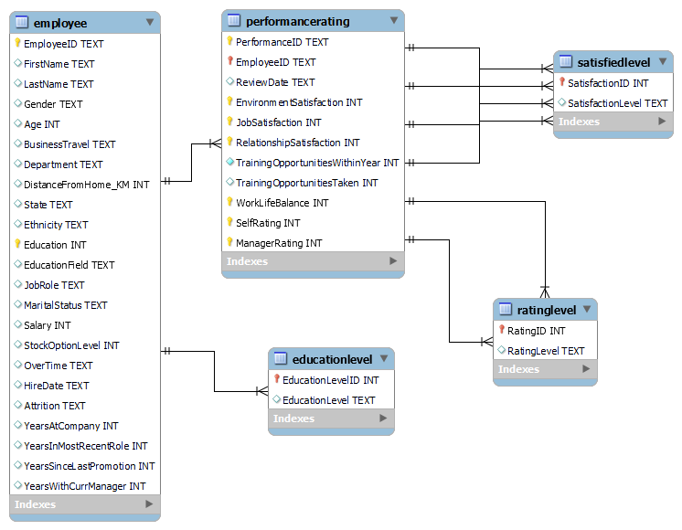
ER DIAGRAM

Slide 7
DATA ANALYSIS AND VISUALIZATION

Slide 8
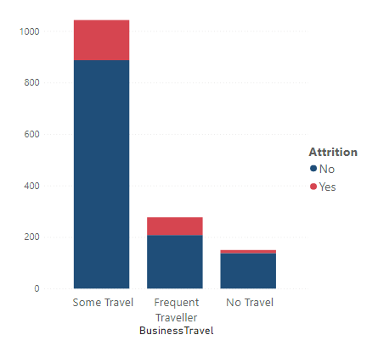
10.61%
BUSINESS TRAVEL AND ATTRITION RATE
Those Employees tend to leave the company most who have few and more travel in their job as compares to those who don’t have travel.
4.69%
0.08%

Slide 9
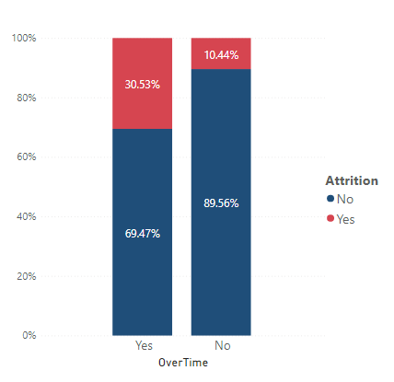
OVERTIME AND ATTRITION RATE
Employees tend to leave the company early who work overtime as compares to those who don’t work overtime.

Slide 10
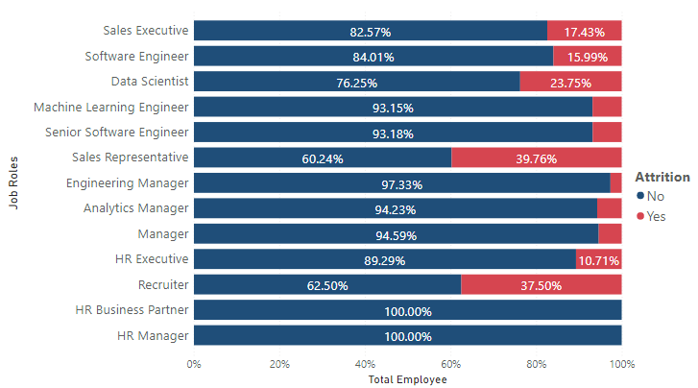
JOB ROLES AND ATTRITION RATE
High Attrition occurs in the following job roles:
Sales Representatives
Recruiter
Data Scientist
Sales Executives
Software Engineer

Slide 11
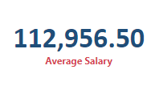
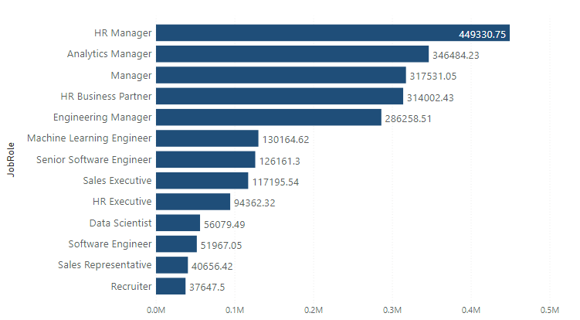
t
JOB ROLES AND AVERAGE SALARY
Job Roles in which attrition is high are also the one who have are getting less paid than the average salary

Slide 12
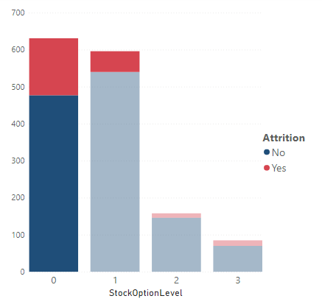
STOCK OPTIONS AND ATTRITION RATE
10%
4%
Majority employees haven’t received any stock option.
Also, majority employees who are leaving have not received any stock option.
Attrition is low in level 02 and 03.

Slide 13
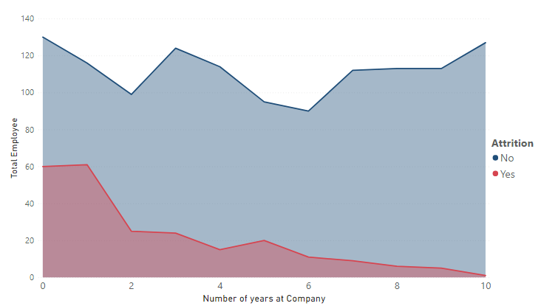
Tenure and attrition rate
In this graph, we analyzed the Tenure of employees at the company.
9% out of 15% Attrition occur in the first 2 years.
New Employees tend to leave early in first 02 years than later years.

Slide 14
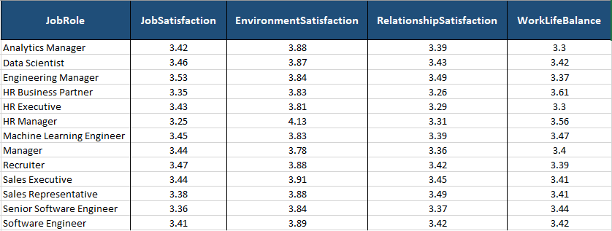
Satisfaction level in job role
Satisfaction Rates
05- Highly Satisfied
04-Satisfied
03-Neutral
02-Dissatisfied
01-Highly Dissatisfied
This is the satisfaction survey in which employees rate different perspective of their job according to their job role.
The results are above Average which indicates that employees are Neutral or Satisfied with the overall job.
The answer to all satisfaction indicator appears above average which is why we suggest that the attrition rate does not relate that much with the ratings.

Slide 15
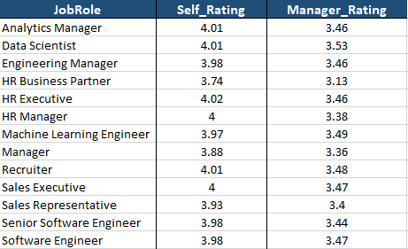
JOB PERFORMANCE AND RATINGS
Satisfaction Rates
05- Above and Beyond
04-Exceeds Expectation
03-Meets Expectation
02-Exceeds Expectation
01-Unacceptable
This is the performance rating survey in which employees rate themselves and manager rate their employees based on their job performance.
Employees tend to rate themselves higher as compared to their managers. It is apparent that the employees might have overrated themselves.

Slide 16
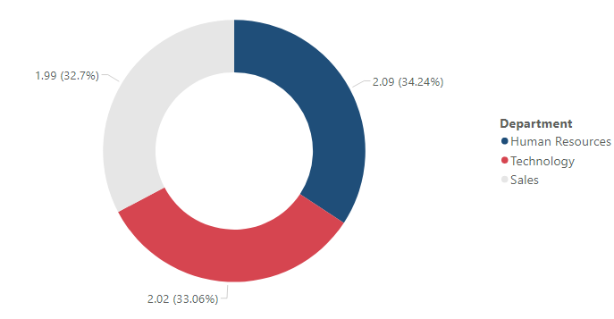
TRAINING OPPORTUNITIES WITH YEAR
The Training Opportunities available within a year is 02 on average. More training opportunities are encouraged in companies to provide career growth prospects to the employees.

Slide 17
INSIGHTS AND RECOMMENDATION
OVERTIME, BUSINESS TRAVEL AND STOCKLEVEL OPTIONS
JOB ROLE AND AVERAGE SALARY
SATISFACTION & PERFORMANCE INDICATORS
From the insights gathered, we understand OVERTIME is the main reason for the attrition rate as 30% of employees are those who do overtime, and still do not receive Stock options. Likely, these individuals do not get enough return for their hard work.
Employees tend to leave early who have Traveled in their job as compares to those who don’t have travel
Through findings, we analyzed that job roles like sales executives, sales representatives, and software engineers have greater attrition rates and the reason could be the average salary.
These roles have less average salary than others and these people do overtime more often and don’t receive valuable salary packages.
The average rating of job satisfaction, Performance satisfaction, environment satisfaction, and work-life balance seems fine, and the rating above average means that employees are satisfied with their job, performance, and environment.
Training opportunities in the technology and sales department are far less than required. This may impact the attrition rate.

Slide 18
RECOMMENDATIONS
Some of the recommendations based on the generated insights are:
Company should revise their travel policies in the job description to facilitate their employees.
Company should offer more stock options specially to those employees who do overtime. So that, employee happily continue their job in the company.
Company should revise the salaries of employees and set market competitive salary packages, offer extra bonuses and incentive to retain them over the long period of time.
Employees should be provided with more training opportunities and workshops so that they can achieve career growth and stay motivated throughout.
Company should work towards providing job satisfaction in the first two years through incentives, healthy environment and relationships so that they are retained.

Slide 19
THANK YOU
Presented By:
Farrah Ejaz farrahnaveed0@gmail.com

